Slide 1
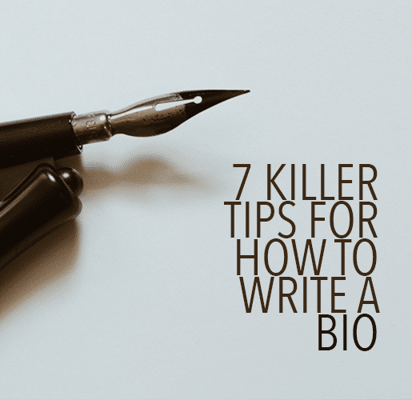

Writing your biography can seem almost as challenging as writing the piece you submitted.
But it is a necessary part of publishing your writing. How will your readers know who wrote your wonderful article if you do not tell them?
The Writer Practice

Slide 2
7 Killer Tips for How to Write a Bio (Including More Examples)
Let me share with you seven tips on how to write a bio and some bio templates to get you started.
1. Write your name
Start with your name. Might seem obvious, but you want to make sure readers know who you are.
2. Share your accomplishments
Don't be shy. Say what you have done.
A list of accomplishments might include things like where you went to school and where you have been published. This is not a time to brag or list every award you've won since grade two. Pick the major accomplishments that are relevant and recent.
For example:
Mary Jones, a graduate of ____________, has been published in____________ and ______________.
If this is your first publication, you can say:
Mary Jones, a graduate of _______________, writes about ________________ and ______________.
The Writer Practice

Slide 3
3. Use third person
Write in the third person, even if you are the one writing it.
Instead of saying, “I have lived in Tokyo and have six cats,” say, “Pamela has lived in Tokyo and has six cats.”
4. Say something personal
End with a personal statement about you. There's not room to tell your life story or share too many personal details, but including a personal detail or two shows readers you are a real person beyond the written page.
5. Be funny
Include humor if it fits the publication you are submitting to. Remember, you don't want to make off-color jokes in your biography, so pretend your mother is reading it.
Unless, of course, it is for an adult magazine. Then you can write humor that fits that publication.
6. Link to your writing
Use only one link. Decide what is the most important place you want your readers to find you. Twitter? Instagram? Your blog signup list?
If you only have one link, have it go to your blog signup page. An email list is the most important, as it gives you direct access to make friends with your readers. You own your blog; you don't own Twitter, Instagram, or Facebook. (Unless of course you DO own them.)
The Writer Practice

Slide 4
Include a link in your bio so readers can find you and follow your writing.
7. Follow the rules
Follow the rules. If they ask for a fifty-word biography, don't give them 324 words. Stick to fifty.
Bonus Tip: Be Yourself
It can seem intimidating to write a killer bio. But you are a writer. You have already written an article or story so amazing that someone wants to publish it.
You can write a fantastic bio, too.
Now You Try
It's a good idea to try out a few different bios for different target audiences. Mix and match professional accomplishments and personal experiences until you have a blend that really captures you as a writer.
You can practice using a conversational tone and then a more formal tone. See which one fits the audience or market you have in mind.
Keep cutting extraneous details until you have a killer bio that represents you, and then polish and edit until it shines.
The handy template above and your own brilliant writing are all you need!
Do you have any tips for how to write a bio?
The Writer Practice

Slide 5
PRACTICE
Take fifteen minutes to write a fifty-word biography. What will you include in your biography? Tell us what you cut and why.
Share the bio you write at our next POP-UP, April 29th. Or feel free to join in our Zoom devoted to our narratives, to be announced.
Contact Carol if you need feedback or additional resources. cs_icrj@att.net
The Writer Practice

